Slide 1

I have $50,000. What to do with it?
Go on a tour
Buy things for others
Buy things for self
Keep it at home
keep it Father’s/ mother’s Vault
Give it to Friends and Family
Save in bank

Slide 2
Mathematics of Finance

Slide 3
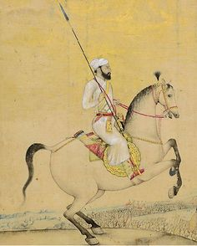
BDT Then vs Now
During 1664-89 Time period Shaista Khan’s (1600 - 1694) rule you could buy 8 Maunds [1 maund is equal to 37.32 kilogram.]
What is Price now?

Slide 4
Time Value of Money: Concept
The concept that a dollar today is worth more than a dollar tomorrow.
Reasons
Inflation: A general increase in prices in other words fall in the purchasing power of money.

Slide 5
Common Terms
Mr. Rajib has $54,000, City Bank is offering him open a FDR Account with 6% annual interest for 5 years.
Present value or Principal (P) The sum/amount of money on which interest is being eared at the beginning of the investment.
Future value (F) The sum/amount of money which will be received after adding the interest with principal at the end of the period.
Interest rate (i) Rate of interest per year
Interest Amount (I) interest amount expressed in currency unit
Number of year (n) the investment life expressed in year
Number of Compounding per year (m) Number of times the interest will be compounded in a year.

Slide 6
Learning
Tarik has 364875 BDT. He invested 50000 BDT. He got 60,000 BDT. Find PV and FV.
Ruka got total $6000 at the end of an investment. Her bank offered $1000 interest in 10 years at 1% simple interest rate compounded semiannually.

Slide 7
Simple and Compound Interest
Simple Interest: interest calculated on the original principal only of a Investment and Loan or on the amount of an account.
Compound Interest: Compound interest is calculated based on both the initial principal and the accumulated interest from previous periods.
Time Period | Investment Example Simple Interest |  |  |  | Time Period | Investment Example Compound Interest
 | Cash Flow | Calculation | P | Int. |  | Cash outflow | Calculation | Cumulative Balance | P | Int.
0 | -1000 |  |  |  | 0 | -1000
1 |  | 1000*10%= 100 | 1000 | 100 | 1 |  | 1000*10%= 100 | 1100 | 1000 | 100
2 |  | 1000*10%= 100 | 1000 | 100 | 2 |  | 1100*10%= 110 | 1210 | 1100 | 110
3 |  | 1000*10%= 100 | 1000 | 100 | 3 |  | 1210*10%=121 | 1331 | 1210 | 121
4 | 1400 | 1000*10%= 100 | 1000 | 100 | 4 | 1464 | 1331*10%=133 | 1464 | 1331 | 133

Slide 8
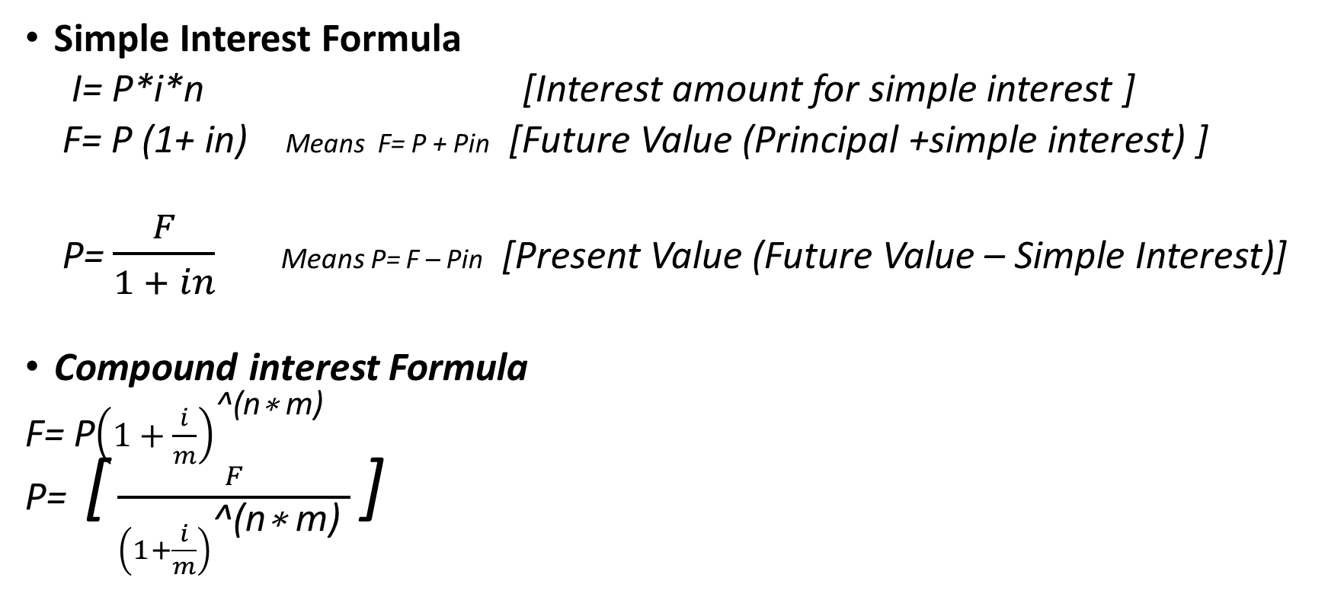
Formula (one time payment)
Simple Interest Formula
I= P*i*n [Interest amount for simple interest ]
F= P (1+ in) Means F= P + Pin [Future Value (Principal +simple interest) ]
P= $\frac{F}{1 + in}$ Means P= F – Pin [Present Value (Future Value – Simple Interest)]
Compound interest Formula
F= P${\left(1+\frac{i}{m}\right)}^{\text{^(}\text{n}\text{∗ }\text{m}\text{) }}$
P= [ $\frac{F}{{\left(1+\frac{i}{m}\right)}^{\text{^(}\text{n}\text{∗ }\text{m}\text{) }}}$ ]
m value
Annually = 1
Seminally = 2
Quarterly = 4
Weekly = 52
Daily= 365 or 360

Slide 9
Simple interest (Exercise)
1) You have 30,000 BDT . If you Invest it after 1 year you got back 40,000. find the interest amount and rate
2) You have 2,00,000 BDT If you Invest it after 1 year you need to pay 5%. Find the interest Rate and Amount.
3)You got 50,000 where 10% was interest rate. And invested 25000.
4) You invested $2500 what at 8% interest for 5 years. Find the interest amount and the future value.
5) Malek received BDT 99000 for an investment which was held for 10 years at 12% interest. Find the interest amount and the Present value.

Slide 10
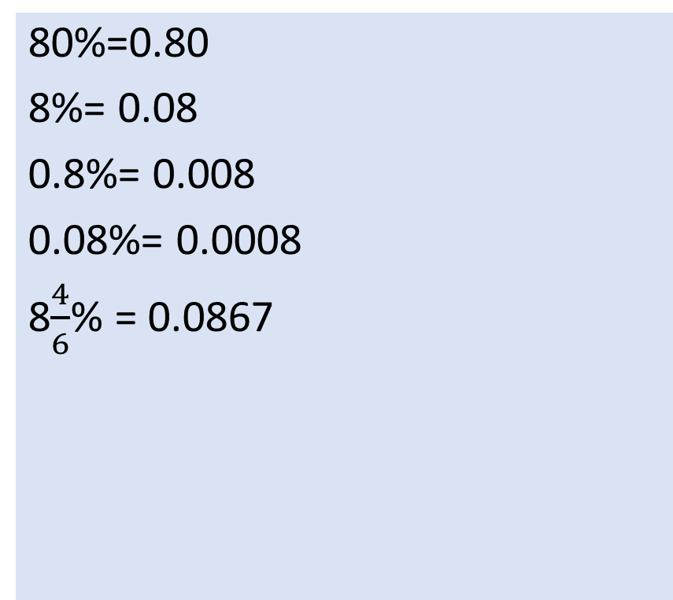
Understanding Rate
Understanding income and cost
80%=0.80
8%= 0.08
0.8%= 0.008
0.08%= 0.0008
8$\frac{4}{6}$% = 0.0867
For Investment interest is income
For Loan interest is cost
Understanding the interest rate is
simple or compound
If the question says the interest is compounded or m value is indicated in the question

Slide 11
Practice
Suppose a Bank Agent promises you to give BDT 1,00,000 after 5 years if you put BDT 85,000 one time in bank. The rate of interest is 10%. Will you accept the offer?
Any process can be used to measure the fusibility of the offer.
We know F= P (1+ in) 1,00,000= P (1+.10*5) P= 66,666.67 To get BDT 100000 I should deposit BDT 66,666.78 do reject the offer. | Or F= P (1+ in) F= 85,000 (1+.10*5) F = 127,000 If we deposit BDT 85,000 it will generate more than 100000 so I reject the offer

Slide 12
Annuity
Annuity is a Series of equal payment made at equal interval of regular time period for fixed duration at an interest rate. There are 2 types of Annuity Ordinary Annuity and Annuity due.
Equal payment= R
Equal interval= m
Fixed duration= n
Interest rate= i

Slide 13
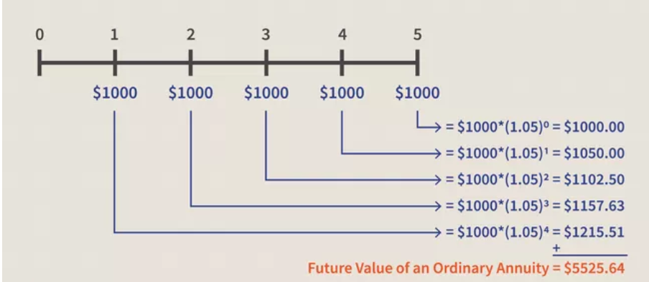
Ordinary Annuity (End of the period)

Slide 14
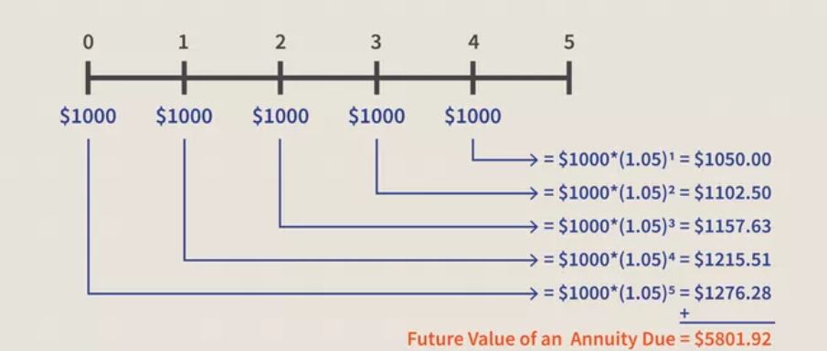
Annuity due (Beginning of the period)

Slide 15
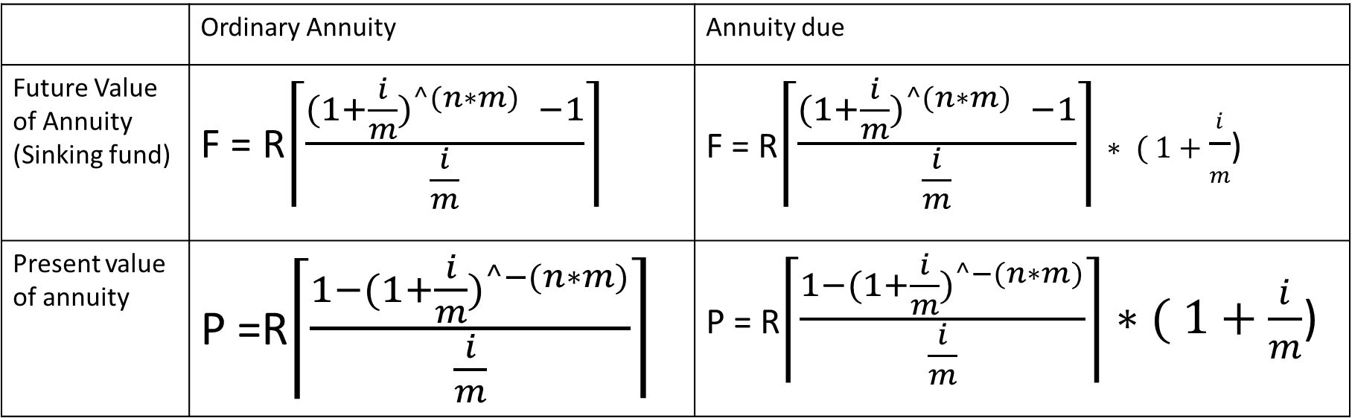
Formula (equal monthly payment)
 | Ordinary Annuity | Annuity due
Future Value of Annuity (Sinking fund) | F = R$\left\lceil \frac{{(1+\frac{i}{m})}^{^(n∗m)} −1}{\frac{i}{m}}\right\rceil$ | F = R$\left\lceil \frac{{(1+\frac{i}{m})}^{^(n∗m)} −1}{\frac{i}{m}}\right\rceil ∗ ( 1+\frac{i}{m}$)
Present value of annuity | P =R$\left\lceil \frac{1−{(1+\frac{i}{m})}^{^−(n∗m)}}{\frac{i}{m}}\right\rceil$ | P = R$\left\lceil \frac{1−{(1+\frac{i}{m})}^{^−(n∗m)}}{\frac{i}{m}}\right\rceil ∗( 1+\frac{i}{m}$)

Slide 16
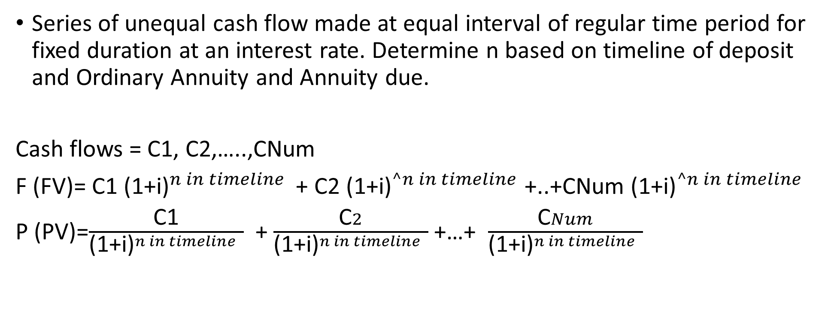
Mixed stream
Series of unequal cash flow made at equal interval of regular time period for fixed duration at an interest rate. Determine n based on timeline of deposit and Ordinary Annuity and Annuity due.
Cash flows = C1, C2,…..,CNum
F (FV)= C1 ${\text{(1+}\text{i}\text{)}}^{n in timeline }$ + C2 ${\text{(1+}\text{i}\text{)}}^{^n in timeline}$ +..+CNum ${\text{(1+}\text{i}\text{)}}^{^n in timeline}$
P (PV)=$\frac{\text{C}\text{1}}{{\text{(1+}\text{i}\text{)}}^{n in timeline } }$ + $\frac{\text{C}2}{{\text{(1+}\text{i}\text{)}}^{n in timeline } }$ +…+ $\frac{\text{C}Num}{{\text{(1+}\text{i}\text{)}}^{n in timeline } }$

Slide 17
ABC Co expects to earn 7% on its investments. So calculate how much would ABC Co receive at the end of 5 years to immediately invest such cash flows?
End of Year | Cash Flow
1 | 10,000
2 | 11,000
3 | 15,000
4 | 12,000
5 | 16,000
Find FV of mixed stream

Slide 18
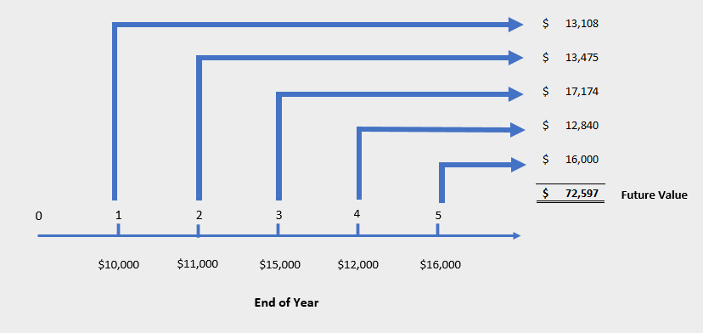
Mixed stream FV of Ordinary annuity

Slide 19
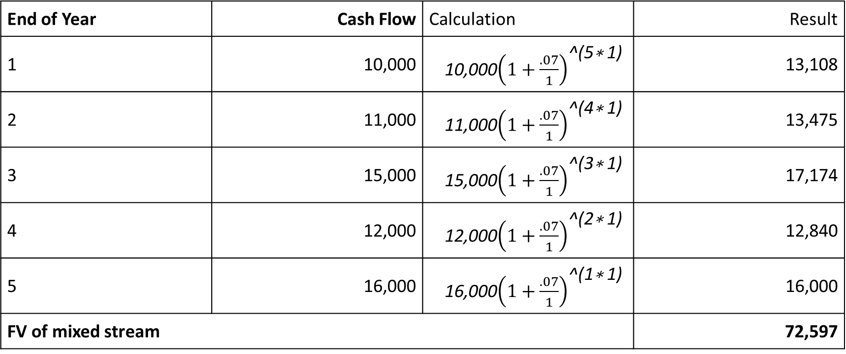
ABC Co expects to earn 7% on its investments. So calculate how much would ABC Co receive at the end of 5 years to immediately invest such cash flows?
End of Year | Cash Flow | Calculation | Result
1 | 10,000 | 10,000${\left(1+\frac{.07}{1}\right)}^{\text{^(}\text{5}\text{∗ }\text{1}\text{) }}$ | 13,108
2 | 11,000 | 11,000${\left(1+\frac{.07}{1}\right)}^{\text{^(}\text{4}\text{∗ }\text{1}\text{) }}$ | 13,475
3 | 15,000 | 15,000${\left(1+\frac{.07}{1}\right)}^{\text{^(}\text{3}\text{∗ }\text{1}\text{) }}$ | 17,174
4 | 12,000 | 12,000${\left(1+\frac{.07}{1}\right)}^{\text{^(}\text{2}\text{∗ }\text{1}\text{) }}$ | 12,840
5 | 16,000 | 16,000${\left(1+\frac{.07}{1}\right)}^{\text{^(}\text{1}\text{∗ }\text{1}\text{) }}$ | 16,000
FV of mixed stream |  |  | 72,597

Slide 20
Let’s continue with the example in the previous article on the future value of a mixed stream cash flow. Suppose ABC Co has been offered an opportunity to receive the future cash flow for the next 5 years as follows:
End of year | Cash Flow
1 | 11,000
2 | 12,000
3 | 14,000
4 | 16,000
5 | 15,000
Find Present value of mixed stream

Slide 21
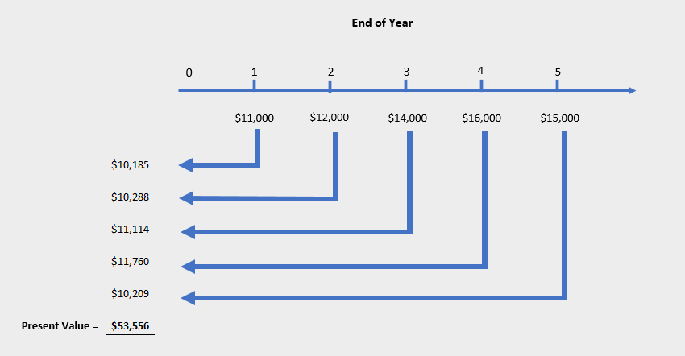
Mixed stream PV of Ordinary annuity

Slide 22
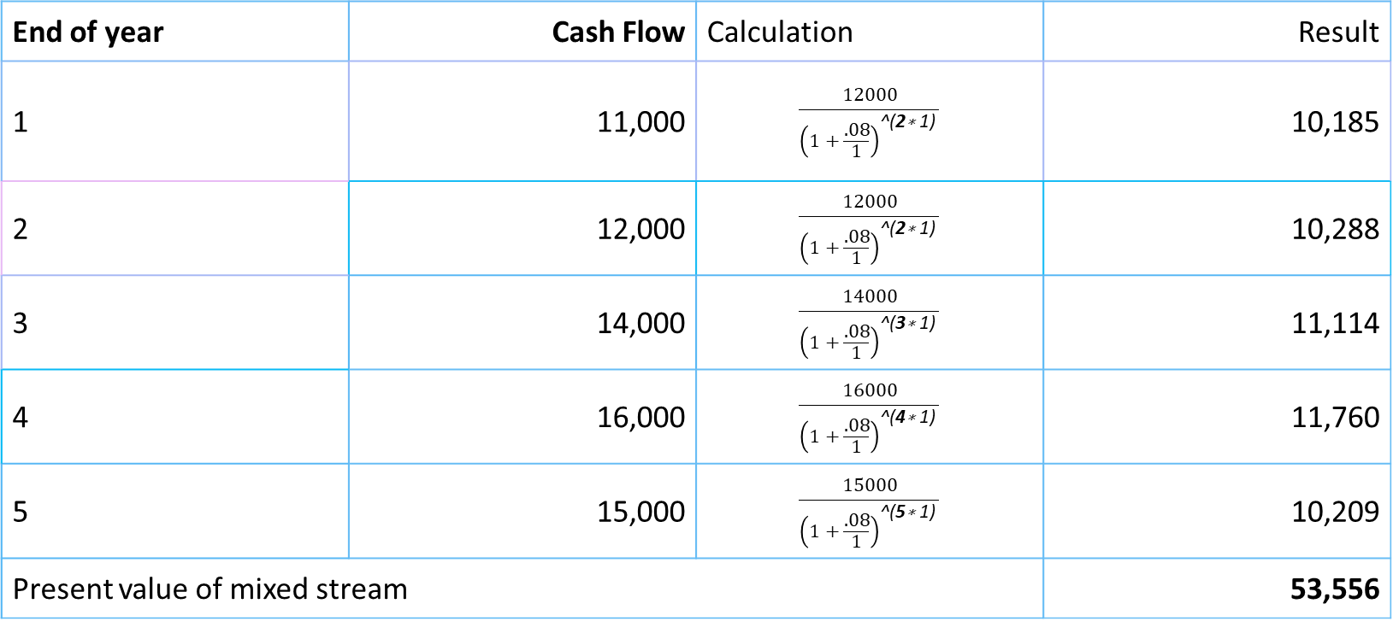
Let’s continue with the example in the previous article on the future value of a mixed stream cash flow. Suppose ABC Co has been offered an opportunity to receive the future cash flow for the next 5 years as follows:
End of year | Cash Flow | Calculation | Result
1 | 11,000 | $$\frac{12000}{{\left(1+\frac{.08}{1}\right)}^{\text{^(}\text{2}\text{∗ }\text{1}\text{) }}}$$ | 10,185
2 | 12,000 | $$\frac{12000}{{\left(1+\frac{.08}{1}\right)}^{\text{^(}\text{2}\text{∗ }\text{1}\text{) }}}$$ | 10,288
3 | 14,000 | $$\frac{14000}{{\left(1+\frac{.08}{1}\right)}^{\text{^(}\text{3}\text{∗ }\text{1}\text{) }}}$$ | 11,114
4 | 16,000 | $$\frac{16000}{{\left(1+\frac{.08}{1}\right)}^{\text{^(}\text{4}\text{∗ }\text{1}\text{) }}}$$ | 11,760
5 | 15,000 | $$\frac{15000}{{\left(1+\frac{.08}{1}\right)}^{\text{^(}\text{5}\text{∗ }\text{1}\text{) }}}$$ | 10,209
Present value of mixed stream |  |  | 53,556

